Slide 1
Narratives in The Early History of F#
Don Syme, Researcher and Community Contributor, Microsoft

Slide 2
A meta-talk about a meta-language
Not a recap of the paper
From 1970s to 2015
From Milner, Newey, Morris to Microsoft and Open Source

Slide 3
History is always written selectively
I’ll be explicit about the narratives I’ve chosen

Slide 4
Narrative #1
A personal journey

Slide 5
Narrative #2
A community’s journey
(and origin mythology)

Slide 6
Narrative #3
Things don’t just happen. Things happen to people, who act, react and change in very human ways
creation, rejection, denial, stubbornness, cooperation, subversion, opportunism, …

Slide 7
Narrative #4
What happens when computing traditions with strong belief systems collide, both in industry and academia?

Slide 8
Narrative #5
The dynamic interplay between academic research and industry concerns

Slide 9

Narrative #6
The golden thread – what holds true in programming language design, what stands the test of time?

Slide 10
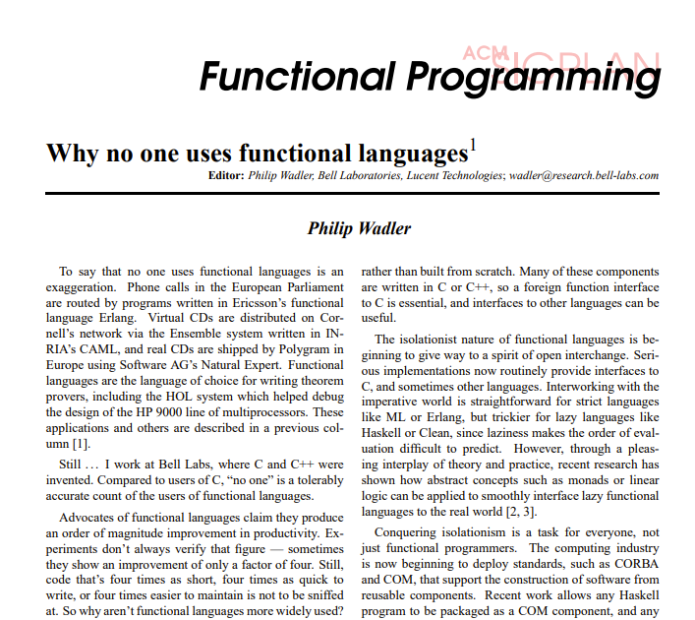
The World as It Was
(~1997)

Slide 11
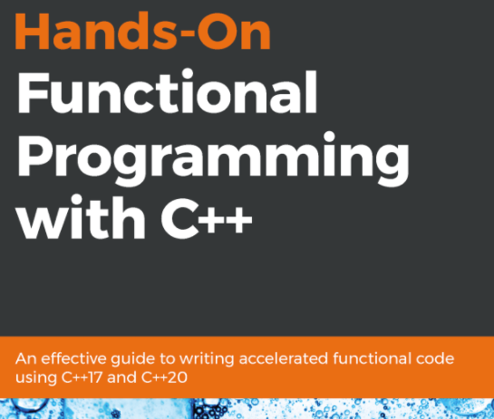
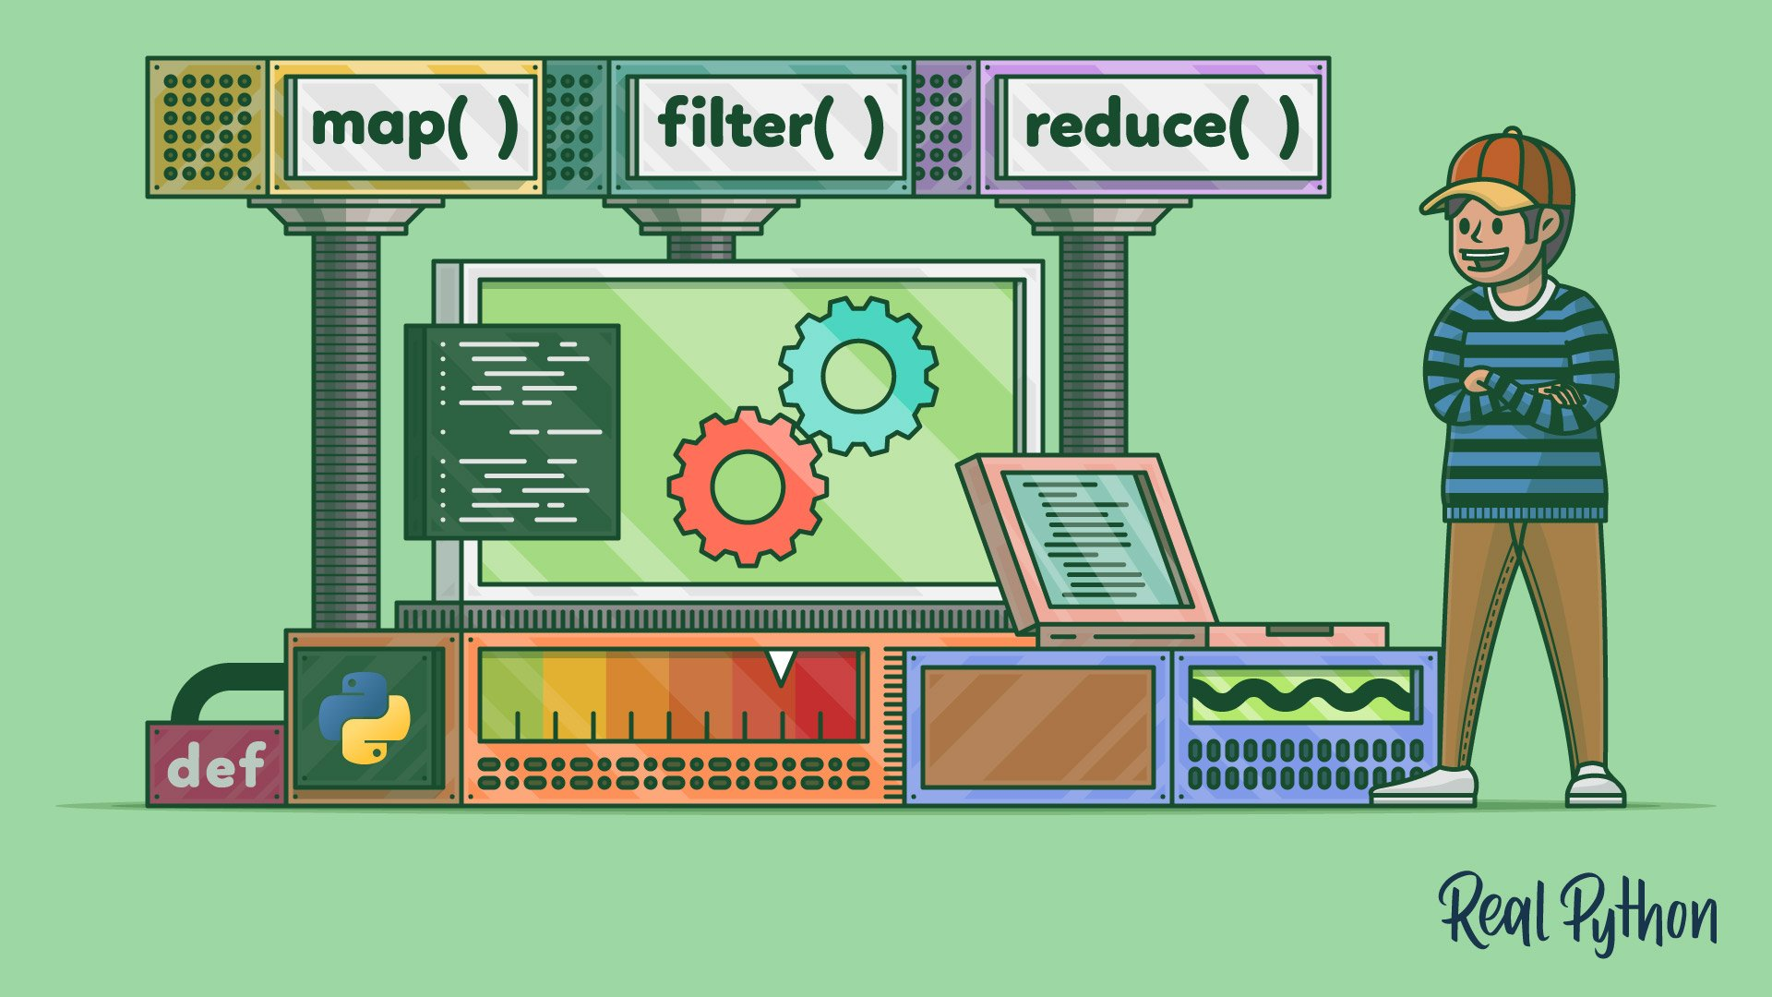
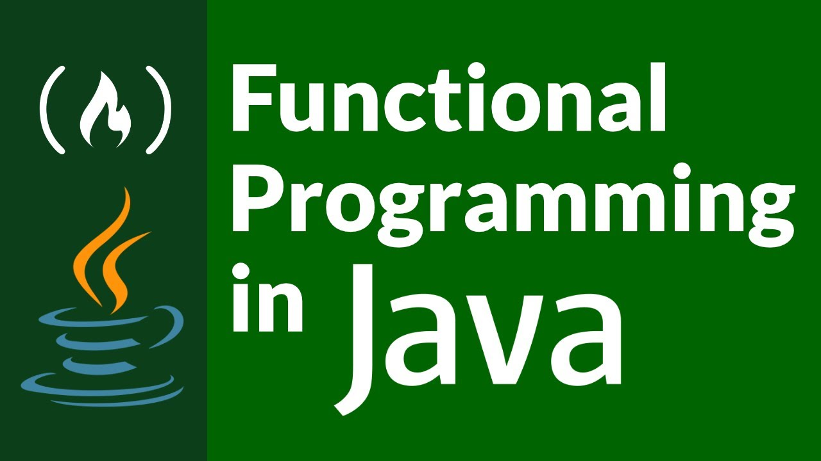
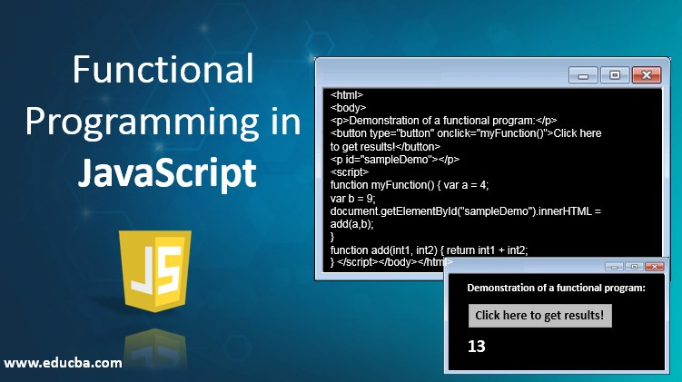
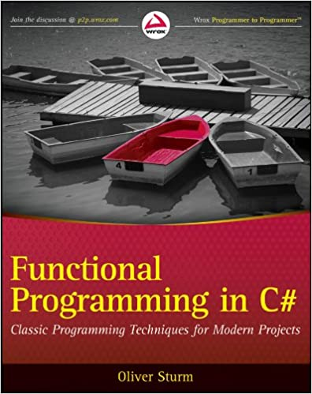
The World Today
Practical Strongly Typed Functional Programming Techniques are Used Everywhere

Slide 12

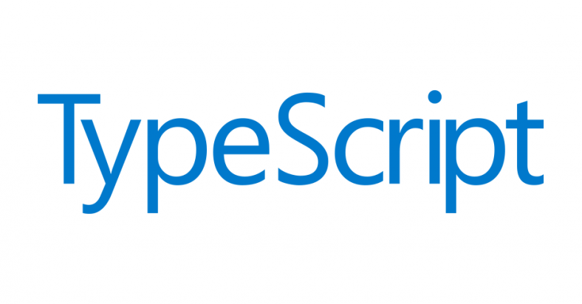


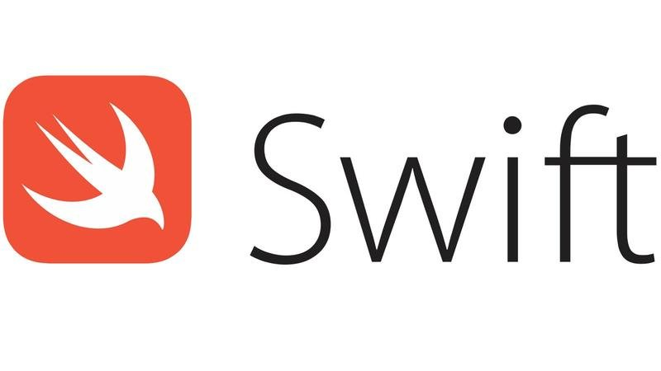
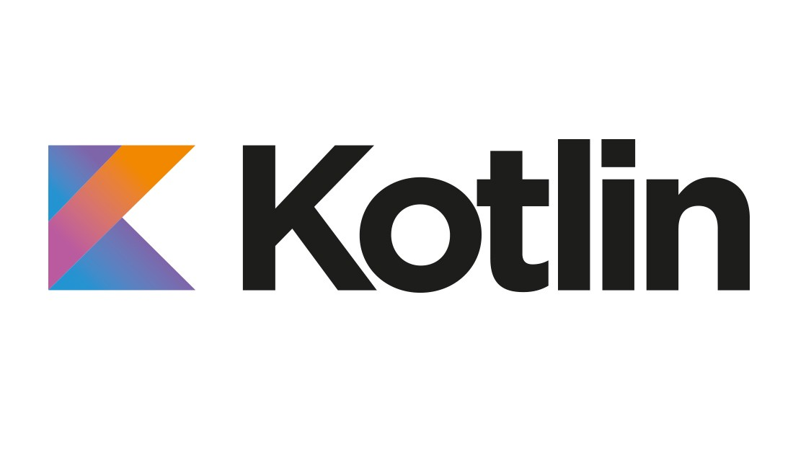
The World Today
Practical Strongly Typed Functional Programming Languages are Usable Everywhere

Slide 13

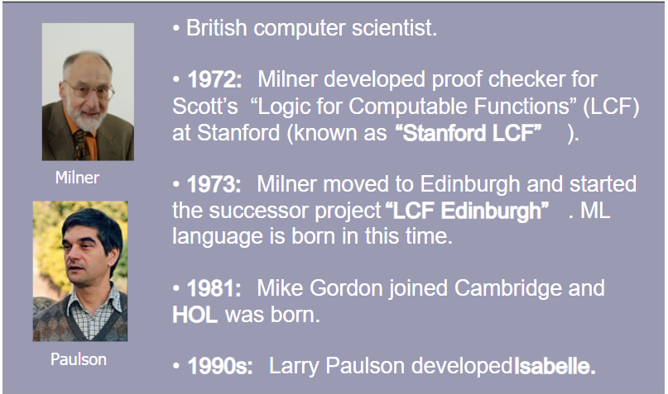
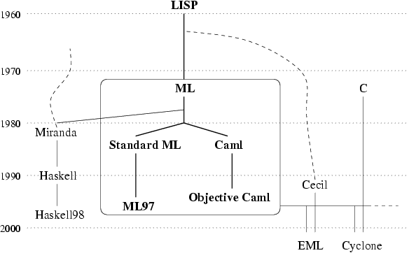

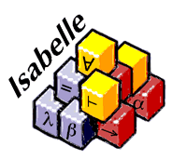
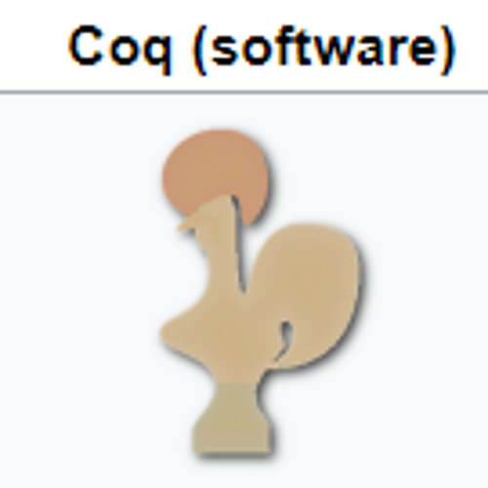
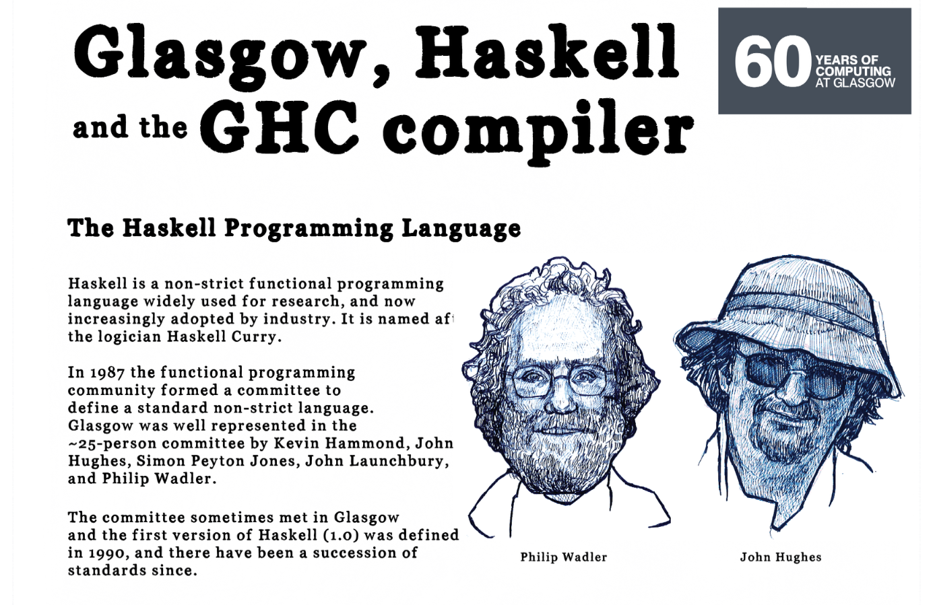
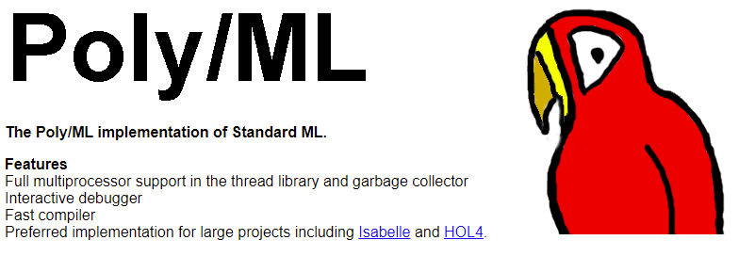
Rollback to 80s-90s
Strongly typed FP was small but active tribe.
Rooted in theorem proving, theory, Standard ML, Haskell, OCaml, experiments

Slide 14

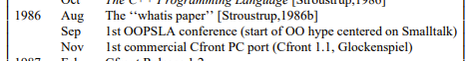
The Object-Oriented Tidal Wave, 1986-1998
A story in itself, colossal impact
On Platform Companies (Obj-C, C++, Java)
On Microsoft (C++, Java)
On CS Academia (Java)
On Every Programming Language

Slide 15
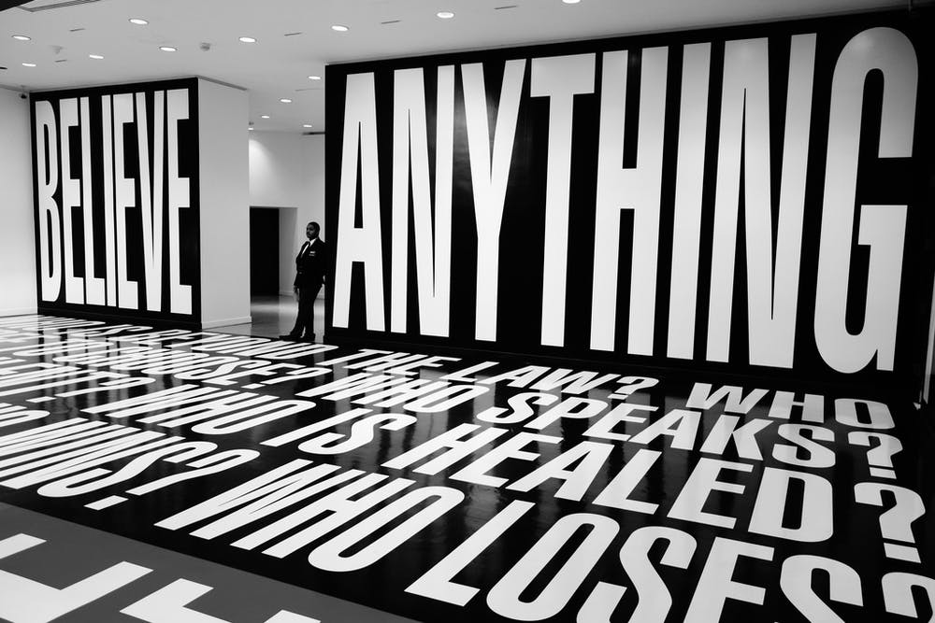
Response 1
Find something else to believe in

Slide 16
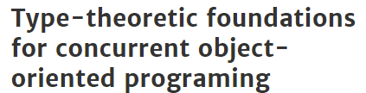
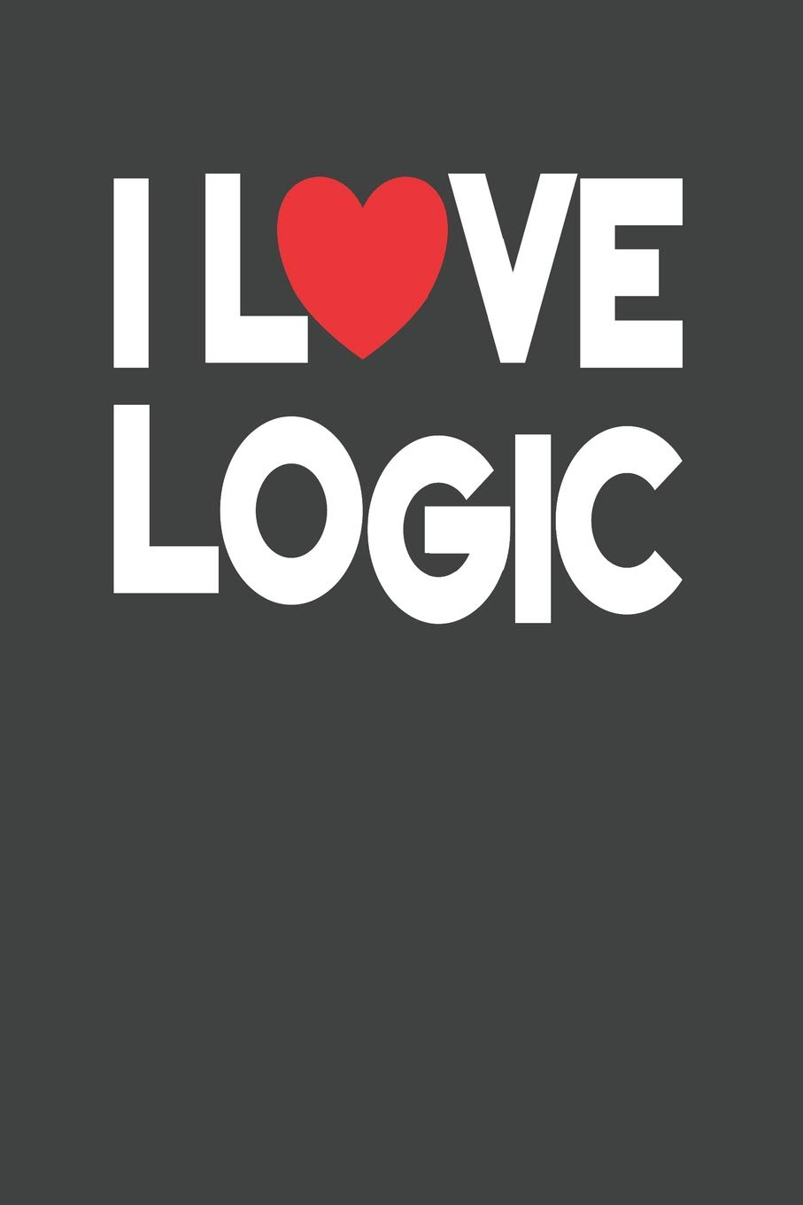



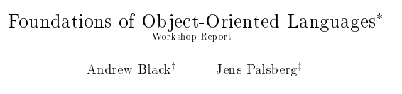
Response 2
Retreat to the fort! Focus on Foundations! Focus on Pure Functional! (and variations)

Slide 17
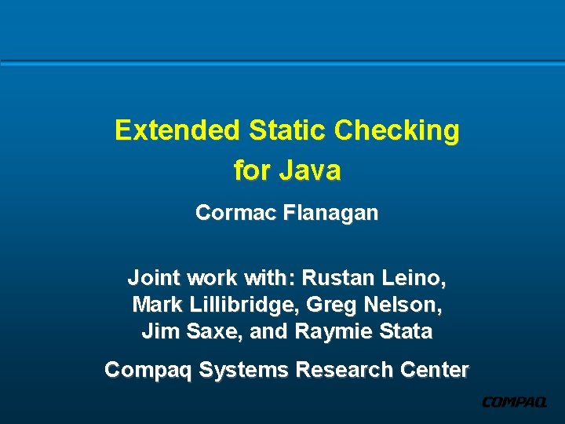

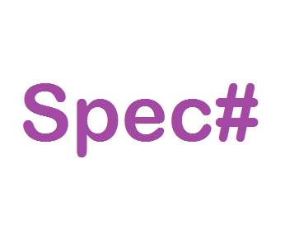
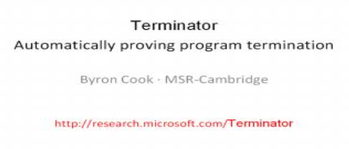
Response 3
Verify the stuff using functional/theory tools!

Slide 18

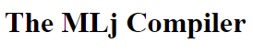
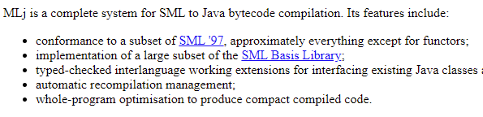
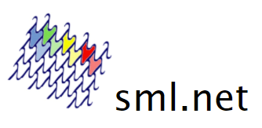
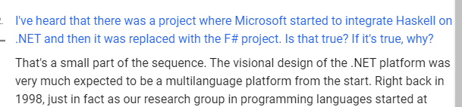
Response 4
Oh yeah! Get my language running on those object VMs!

Slide 19
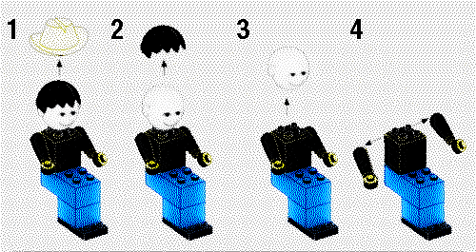
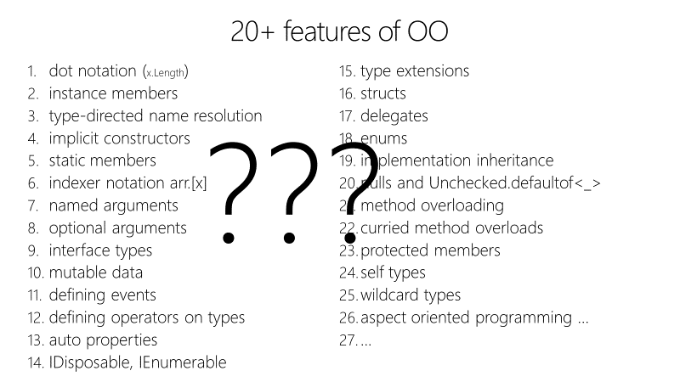
Response 5
Rationally deconstruct Functional and Object Programming

Slide 20


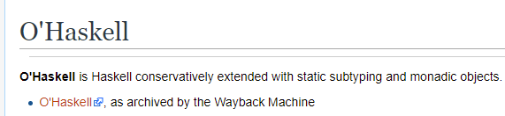
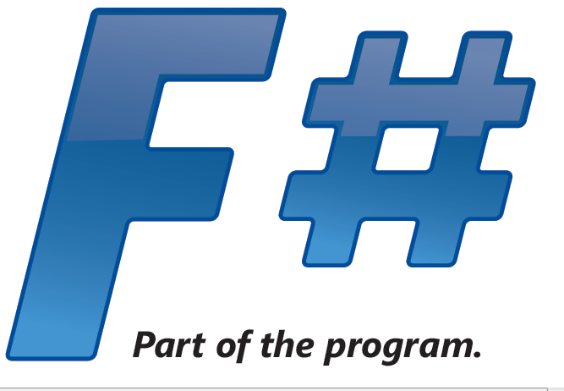
Response 6a
Seek a synthesis!
Make Functional Languages more Object-Oriented!

Slide 21
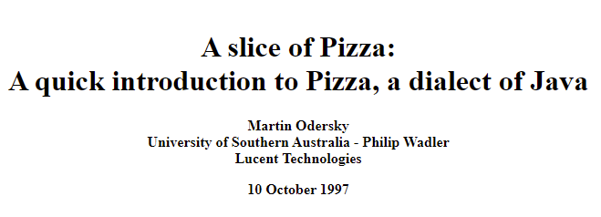
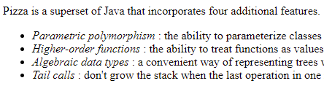





Response 6b
Seek a synthesis!
Make Object-Oriented Languages more Functional!
+ many other more recent examples

Slide 22
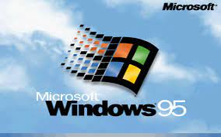
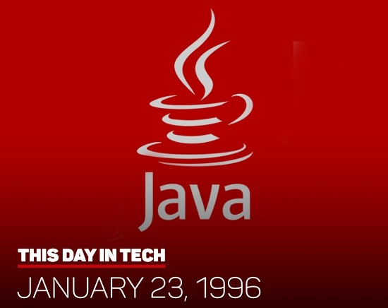
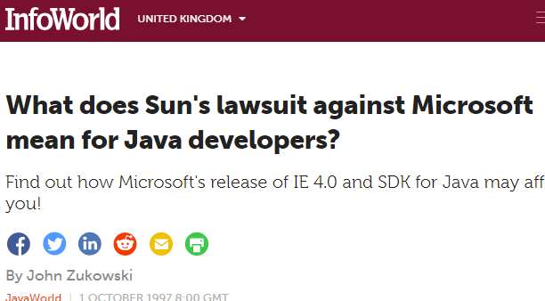


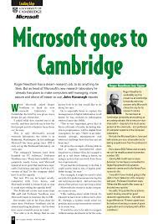

Meanwhile…. Over at Microsoft….

Slide 23
1997 – Microsoft Research founded in Cambridge
The worlds of Robin Milner and Bill Gates collide…
All the tribes of computer science descend on Microsoft and Microsoft Research..
Much early work centred on .NET

Slide 24
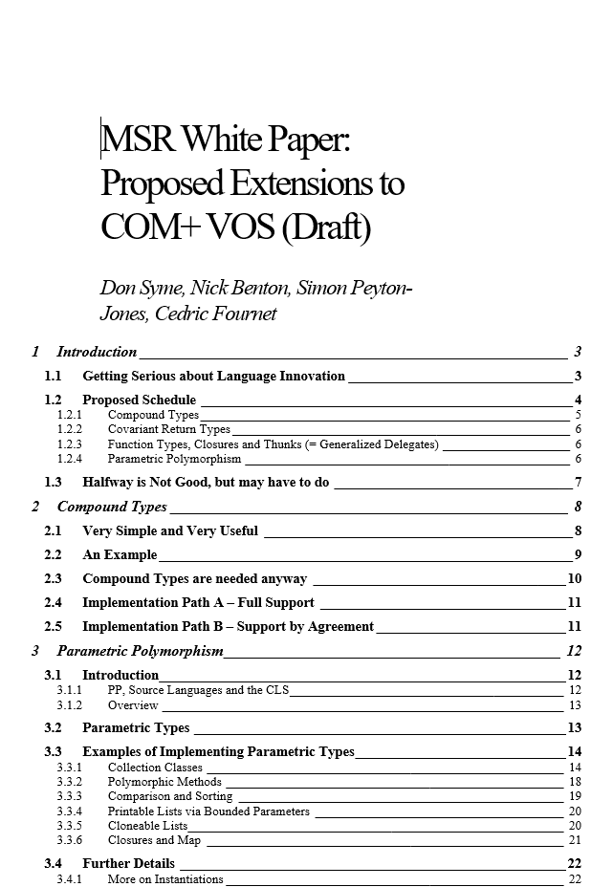
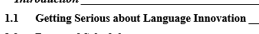
.NET Generics (1998-2004)
Breaking through the nominal, class-based Object-Oriented wall
Built on GJ, Pizza by Wadler/Odersky et al
“Puts .NET 20 years ahead”

Slide 25
By 2002 .NET Generics was safely landed
However, C# 2.0 was still verbose, unusable, untrustworthy (relative to FP)
Sample after sample showed 3x-5x code size difference for like-for-like, full of null checking etc.

Slide 26
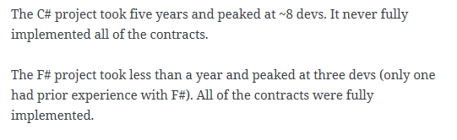
A later example
350,000
lines of C# OO
by offshore team
30,000
lines of robust F#, with
parallel +more features
An application to evaluate the revenue due from Balancing Services contracts in the UK energy industry
http://simontcousins.azurewebsites.net/does-the-language-you-use-make-a-difference-revisited/

Slide 27
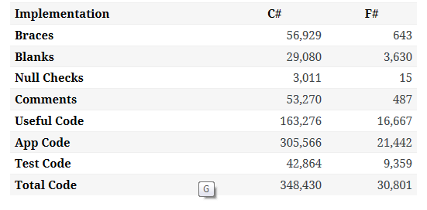

Slide 28
F# 1.0 was born from an obsessive compulsion - “we must do this or else what else are we here for?”
A desire to ensure strongly-typed FP was a real option in the 2000s

Slide 29
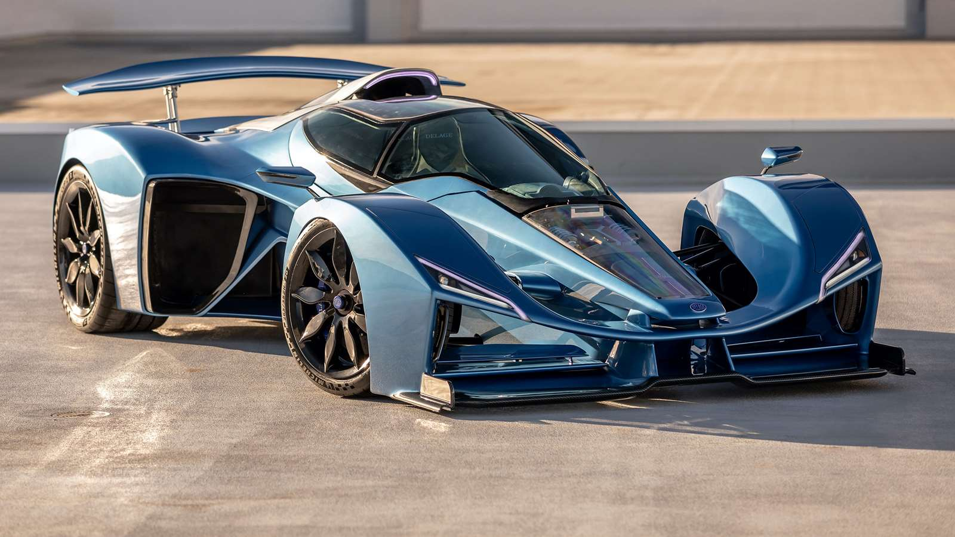
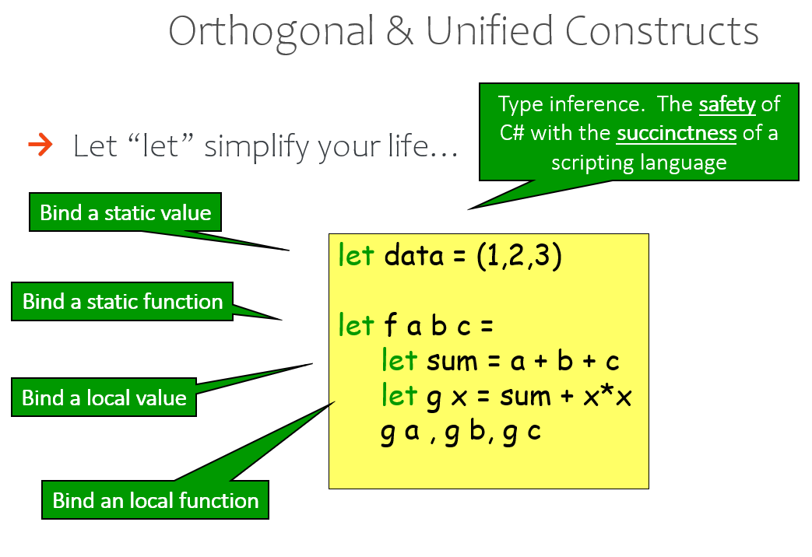
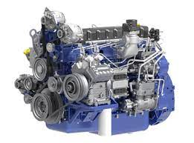
Starting with Core Caml
OCaml
.NET Runtime
(This is a truck engine)

Slide 30
The F# approach
Start with Core Caml
Stay true to core FP principles
Interoperate
Reuse industrial VM+ecosystem
Deconstruct OO, FP, find synthesis
Include IDE tooling, REPL
Deliver and apply in industry
Long-term home at Microsoft (Research)
Focused iterative improvements

Slide 31
Breaking the Rules of the Strongly Typed Functional Tribe
Beliefs held, Beliefs lost, Beliefs gained

Slide 32
Type definitions, modelling, objects
Soundness and
Formalization
Parameterization
Expression-oriented programming
Runtime, ecosystem, interop
Types and Type Inference
Computational
modalities
(comprehensions, async, monads, monoids…)

Slide 33
Nominal objects (classes, interfaces)
Structural objects
Languages must have a formal specification!
Functors (parameterized large components)
Type definitions
Functional objects
Soundness
Soundness is supreme
Functional abstraction and parameterization
Parameterization
Immutable by default, algebraic data
Initialization soundness, no nulls
Expression-oriented programming
Types for modelling, perf, correctness, interop
“F# types are .NET types, .NET types are F# types”
Hindley-Milner for typed succinctness
List comprehensions
Types and Type Inference
Interop
Hindley-Milner modified for objects+more
Monadic notation
Type Providers
Computational
modalities
Fast generic unboxed arith + inline
Rich, compositional computation notation (for comprehensions, queries, async, monads, monoids, applicatives…)
Type-classes and type-level computation
Types for logic and proof

Slide 34
Resolving some of the Contradictions of the Strongly Typed Functional Tribe
When a tribe encounters the glaring judgment of other tribes, it must face up to the flaws in its beliefs

Slide 35
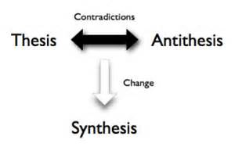

Slide 36
Contradiction #1
All practical typed languages need cheap and effective type declarations that include encapsulation
Previous MLs had awkward variants of that (abstype)
Functional
Objects
2006: F# Object Programming
modified Hindley-Milner, type-directed name resolution,
nominal, subtype-friendly, delegation-oriented, expression-friendly

Slide 37
F# : Objects + Functional ️
Recovers ergonomic simplicity
for encapsulation, works with type inference
and interop, immutable by default
type Vector2D(dx:double, dy:double) =
let d2 = dx*dx+dy*dy
member _.DX = dx
member _.DY = dy
member _.Length = sqrt d2
member _.Scale(k) = Vector2D (dx*k, dy*k)
Inputs to object
construction
Functional object internals
Exported properties
Exported method

Slide 38
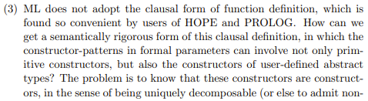
Contradiction #2
Pattern matching only over concrete representations is, in practice, a catastrophe
This was a contradiction in all functional languages until F#
https://www.pure.ed.ac.uk/ws/portalfiles/portal/17084823/Milner_R_1982_How_ML_Evolved.pdf
Pattern Matching
Abstraction
2006: F# Active Patterns
Views made practical and simple.
Concomitant with Scala extractors, leads to Haskell view patterns (less used), C# pattern matching

Slide 39
Contradiction #3
MLs had no list comprehensions
MLs had no monad syntax
MLs had nothing like this, and it really hurt in practice
Lambda is everything
Computational modalities
(co-routines, tasks, multi-threading, monads, monoids, comprehensions, queries, DSLs)
1993: OCaml embraces Algol-like control syntax within an expression-based functional language
2007: F# Comprehensions, Async and Computation Expressions gives modal interpretation to this

Slide 40
Computational modalities in C#, F# (computation expressions)
C# Iterator methods (from Icon)
C# Query expressions
modality { code }
C# Collection initialization
C# Async methods
2007 – monads, monoids, async, comprehensions
2012 – queries, extended comprehensions
2020 – applicatives
C# Async iterator methods

Slide 41
Computational modalities in C#, F# (computation expressions)
C# Iterator methods
seq { code + yield }
C# Query expressions
query { code + yield + custom }
C# Collection initialization
list { code + yield }
C# Async methods
async { code + let! }
C# Async iterator methods
asyncSeq { code + let! + yield }
coroutine { code + yield() }

Slide 42
seq { … }, [ … ], [| … |]
✗
✓
let rec allSymbolsInEntities compGen (entities: FSharpEntitylist) =
List.concat [
entities;
(e.GenericParameters
|> List.filter (fun gp -> compGen || not gp.IsCompilerGenerated));
(e.MembersFunctionsAndValues
|> List.filter (fun x -> compGen || not x.IsCompilerGenerated)
|> List.collect (fun x ->
List.cons x
(x.GenericParameters
|> List.filter (fun gp -> compGen || not gp.IsCompilerGenerated))));
e.UnionCases;
(x.UnionCaseFields
|> List.filter (fun f -> compGen || not x.IsCompilerGenerated));
(x.Fields
|> List.filter (fun f -> compGen || not x.IsCompilerGenerated));
allSymbolsInEntities compGen e.NestedEntities ]
let rec allSymbolsInEntities compGen (entities: FSharpEntitylist) =
[ yield! entities
for gp in e.GenericParameters do
if compGen || not gp.IsCompilerGenerated then
yield gp
for x in e.MembersFunctionsAndValues do
if compGen || not x.IsCompilerGenerated then
yield x
for gp in x.GenericParameters do
if compGen || not gp.IsCompilerGenerated then
yield gp
yield! e.UnionCases
for f in x.UnionCaseFields do
if compGen || not f.IsCompilerGenerated then
yield f
for x in e.FSharpFields do
if compGen || not x.IsCompilerGenerated then
yield x
yield! allSymbolsInEntities compGen e.NestedEntities ]
v.

Slide 43
History of async/await and computational modalities in C#, F#
C#
F#
1970-90s
MLDonkey,
List Comprehensions,
Haskell Monads,
Coroutines, Promises
SNOBOL,
Icon Iterators
2002, Todd Proebsting,
MSR, Uni Arizona
C# 2.0 Iterator Methods
2002
ML, Haskell, COmega
2006, Erik Meijer,
Microsoft
F# 1.9 Sequences
F# 1.9 Async/Await
F# 1.9 Comprehensions
F# 1.9 Comp. Exprs.
2007
C# 3.0 LINQ queries
Axum+others
Gustaffson et al,
Microsoft
F# 3.0 CEs Support Queries
F# 3.0 CEs Support Async Sequences
2011
C# 5.0 Async/Await
Hejlsberg,
Torgersen et al
Async/Await in Python, C++, Java,
Typescript + others
Haskell Applicatives
Torgersen
et al
2020
C# 8.0 Async Iterator Methods
F# 5.0 CEs Support Applicatives

Slide 44
Contradiction #4
No versions of ML had taken data-access or data interop seriously
F# had some libraries from .NET. However we wanted more fluency, more automation, more programmability of interop
Typed Code
External Data
2012: F# Type Providers
(compile-time meta-programming to compute type
spaces based on external information sources)

Slide 45
The Later History of F# (2012+)
So much I could say about this, but it’s more like “normal” language history
2010 – F# 2.0 released as supported Microsoft language, “Parachutes Into the Dark Heart of the Industry”
2012+ – F# 3.0, 3.1
2014-2016 – C#, F# and .NET Become Normal, Cross-Platform, Open-Source
2016+ – F# 4.0, 4.1, 4.5, 4.7
2020 – F# 5.0

Slide 46
F# Today
So much I could say about this too
F# has a strong position as the “functional language for .NET”
Delivery in the .NET SDK, F# exists wherever C# exists
Also Fable, a Javascript compiler for F#
Highly performant
IDE tooling by two major vendors
Strong stories for web-client, mobile, server, cloud, deep-learning
Fully open design and engineering processes
A practical functional-first methodology
An engaged and enjoyable community

Slide 47
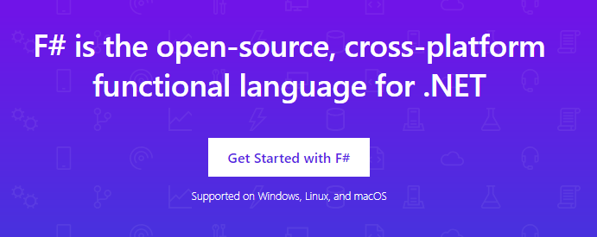
www.microsoft.com/net/

Slide 48
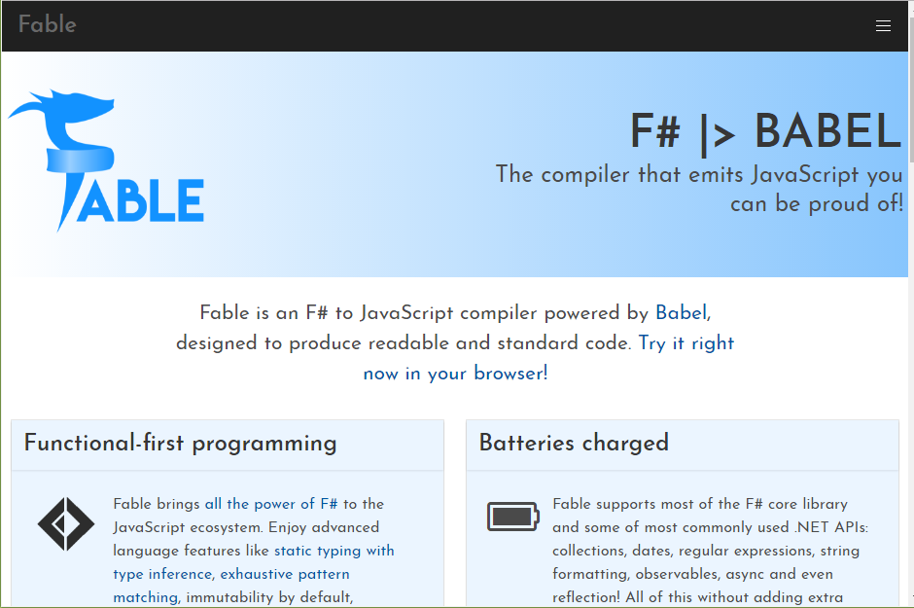

Slide 49
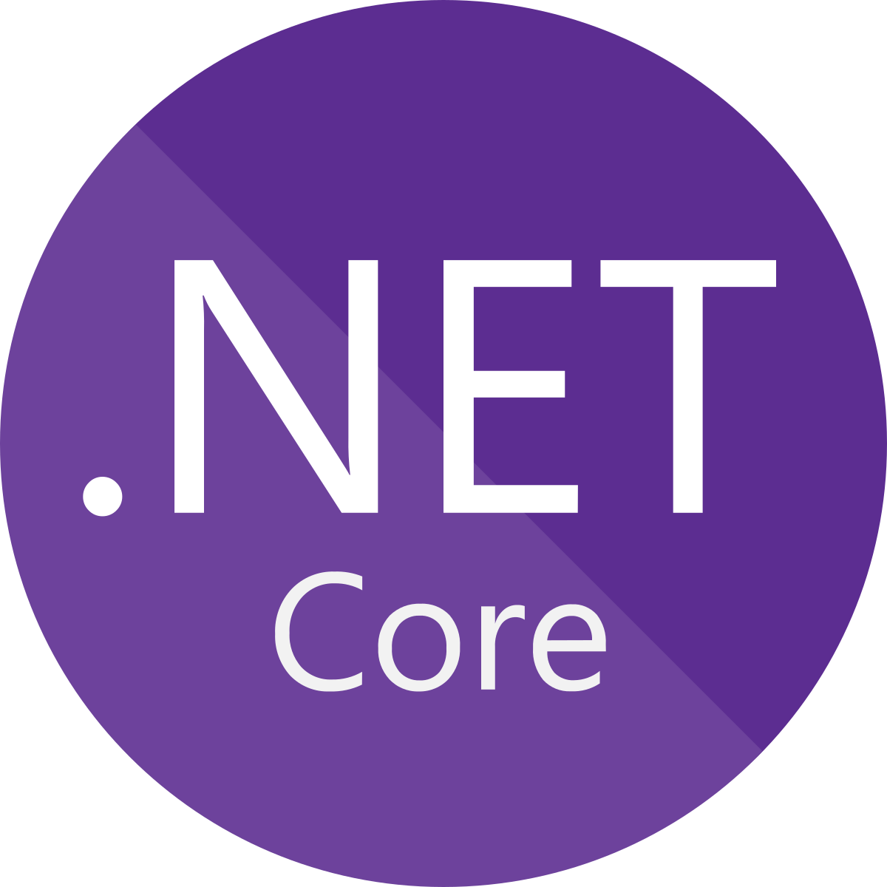





F# get started dotnet new -lang F# dotnet build

Slide 50
The influence of F#
Culturally, F# core team existed “right next door” to C# core team, leading to many direct influences both ways
via Hejlsberg, Meijer, Hoban, Parsons, Torgersen + others

Slide 51
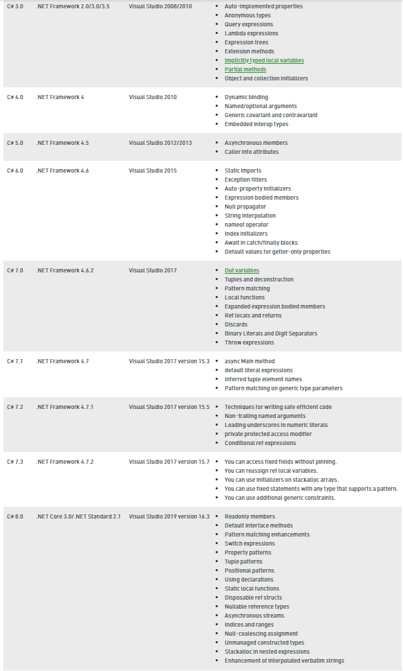
+ C# 9.0 records, top-level statements

Slide 52
Other Influences of F#...
Scala (via Odersky + others – extractors + more)
TypeScript, Swift, Elm, Kotlin (F# was a reference point)
Python (via C# - async)
Java, C++ … (via C# - async)

Slide 53
Concluding Remarks

Slide 54
Concluding Notes
The programming world has corrected the OO dominance of the late 90s
Generics, lambdas, parameterization, immutability, algebraic types, various computational modalities, type inference have now rightly occupied their place as practical core techniques in nearly all programming languages
F# has been a part of this story since 2003
Part of the reaction of the functional tribe to the OO tidal wave
Stayed true to its core design goals
Many practical additions to the expression-oriented, statically typed paradigm
A strong user base and a secure future

Slide 55
The golden thread is the simplicity of the core experience, e.g.
let f x = (x, x)
type term = T of string * term list
…
Milner, Newey, Morris saw this in 1970, I personally experienced it in 1992, and it’s stayed true.

Slide 56
This golden thread of strongly-typed functional programming will appeal far into the future
Thanks!

Slide 57
Backup slides

Slide 58
F# 1.0 – 5.0
Dialectics in Action

Slide 59
Functional
Interop
2004: F# 1.0 on .NET
2016: Fable on Javascript

Slide 60
F# get started dotnet new -lang F# dotnet build

Slide 61
F# get started dotnet new -lang F# dotnet build
F# tools are part of the .NET SDK, available everywhere

Slide 62

F# for the backend dotnet new -i "giraffe-template::*" dotnet giraffe
A functional ASP.NET Core micro web framework for building rich web applications.
github.com/giraffe-fsharp/Giraffe

Slide 63
F# for the backend dotnet new -i "giraffe-template::*" dotnet giraffe
A functional ASP.NET Core micro web framework for building rich web applications.
High perf, functional server-side programming
github.com/giraffe-fsharp/Giraffe

Slide 64

F# for the frontend (JS) dotnet new -i "Fable.Template::*" dotnet new fable npm install npm start

Slide 65
F# for the frontend (JS) dotnet new -i "Fable.Template::*" dotnet new fable npm install npm start
You can use F# as a Javascript language

Slide 66


F# for the full stack dotnet new -i SAFE.Template dotnet new SAFE dotnet tool restore dotnet fake run
=
+

Slide 67


A $3B Unicorn, Built on F#

Slide 68
F# 5.0! (2021) ✔ #r nuget packages in scripts “#r "nuget: Newtonsoft.Json" ✔ Jupyter and .NET Interactive notebooks! ✔ string interpolation ✔ nameof ✔ applicatives syntax in computation expressions ✔ improved .NET interop ✔ improved Map/Set performance + more
https://github.com/fsharp/fslang-design/tree/master/FSharp-5.0

Slide 69
Enter F# Type Providers…. “Just like a library” “A design-time component that computes a space of types and methods on-demand…” “An adaptor between data/services and the .NET type system…” “On-demand, scalable compile-time provision of type/module definitions…”

Slide 70
https://fsprojects.github.io/FSharp.Data/images/json.gif

Slide 71
20+ features of OO
dot notation (x.Length)
instance members
type-directed name resolution
implicit constructors
static members
indexer notation arr.[x]
named arguments
optional arguments
interface types
mutable data
defining events
defining operators on types
auto properties
IDisposable, IEnumerable
type extensions
structs
delegates
enums
implementation inheritance
nulls and Unchecked.defaultof<_>
method overloading
curried method overloads
protected members
self types
wildcard types
aspect oriented programming …
…
???

Slide 72
Some make F# a better API language Some make F# a better implementation language Some are part of an interop standard Some are not needed

Slide 73
Where do we stand?
Embrace
dot notation (x.Length)
instance members
type-directed name resolution
implicit constructors
static members
indexer notation arr.[x]
named arguments
optional arguments
interface types and implementations
mutable data
operators on types
auto properties
IDisposable, IEnumerable
type extensions
events
structs
delegates
enums
type casting
large type hierarchies
implementation inheritance
nulls and Unchecked.defaultof<_>
pervasive method overloading
curried method overloads
protected members
self types
wildcard types
aspect oriented programming …
…
Down the object rabbit hole
Use where necessary, use tastefully, use respectfully, use sparingly
Not supported

Slide 74
The 20+ features of OO
Love
dot notation (x.Length)
instance members
type-directed name resolution
implicit constructors
static members
indexer notation arr.[x]
named arguments
optional arguments
interface types and implementations
mutable data
operators on types
auto properties
IDisposable, IEnumerable
type extensions
events
structs
delegates
enums
type casting
large type hierarchies
implementation inheritance
nulls and Unchecked.defaultof<_>
pervasive method overloading
curried method overloads
protected members
self types
wildcard types
aspect oriented programming …
…
Mostly Avoid
Tolerate
Forget

Slide 75
Functional
 | Expression-oriented | No null | Multiple Args = Tuples | Closure and Capture | First-class Values | Currying | HM Type Inference
void (unit) | ✓ | ✓ | ✓ | ✓ | ✓ | ✓ | ✓
Object Types | ✓ | ✓ | ✓ | ✓ | ✓ | ✓ | ✓
Subtyping | ✓ | ✓ | ✓ | ✓ | ✓ | ✓ | ✓
Dot-notation | ✓ | ✓ | ✓ | ✓ | ✓ | ✓ | ¾
Inheritance | ✓ | ✓ | ✓ | ✓ | ✓ | ✓ | ¾
Method Overloading | ✓ | ✓ | ✓ | ✓ | ¾ | ✗ | ¾
Objects
Relatively Graceful Degradation
(some type annotations needed)
Relatively Graceful Degradation
(some type annotations needed)
Some combinations outlawed for sanity

